Slide 1
Heads-Up Display UROP
Jennifer Madiedo

Slide 2
Objectives
Hardware
Set up Arduino with LCD Screen and create sketch to display information from raspberry pi
If time allowed: set up Arduino with thermal printer and create accompanying sketch
Software
Write sample python code for integration with open ag brain to get environmental data

Slide 3
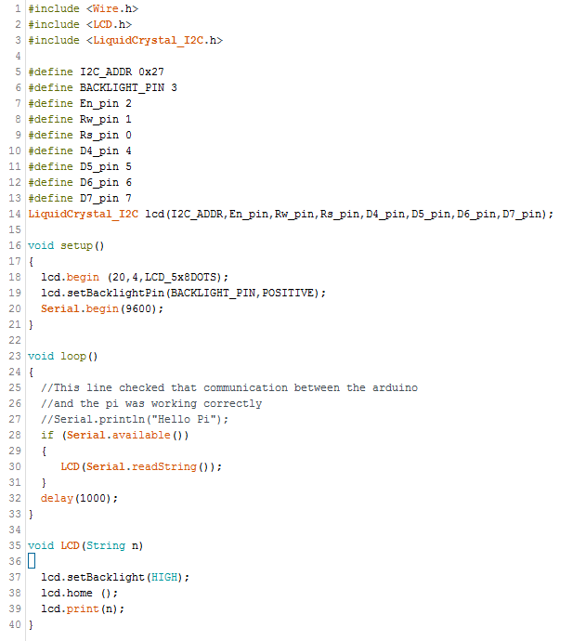
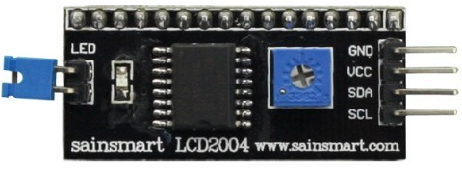
LCD Sketch
Runs with the new Liquid Crystal Library for Arduino (replacing older version)
Setup with SainSmart LCD2004 backpack
Only requires 4 connections: Vdd, Gnd, SDA and SQL pins (digital communication pins)

Slide 4
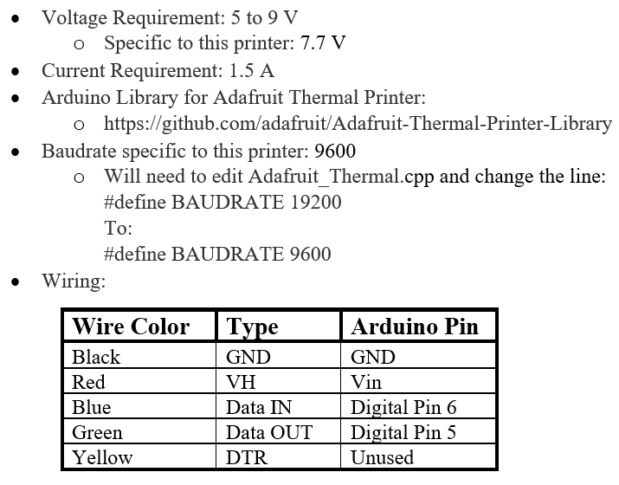
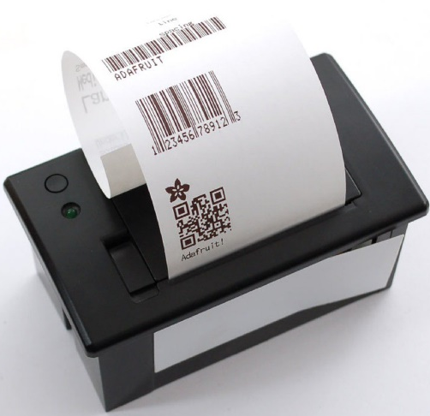
Thermal Printer Setup

Slide 5
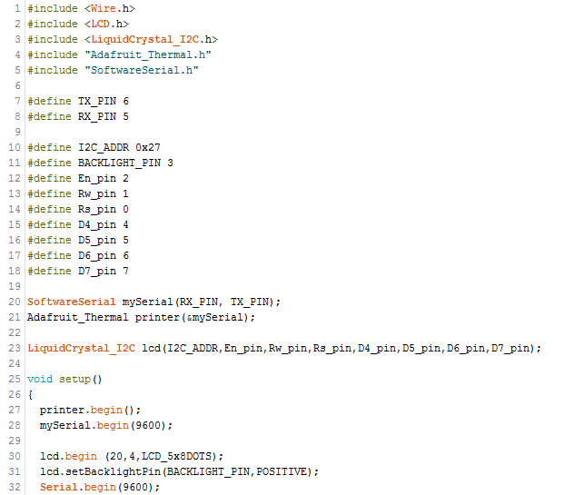
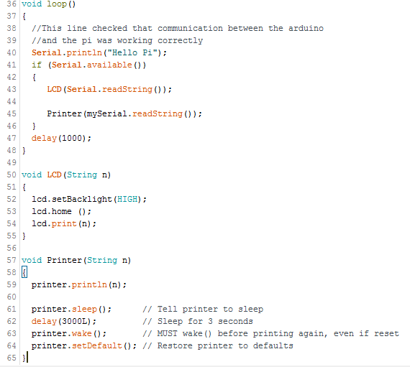
LCD & Thermal Printer sketch

Slide 6
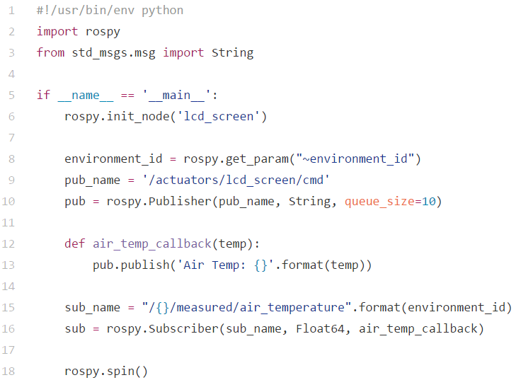
Python/ROS Code

Slide 7
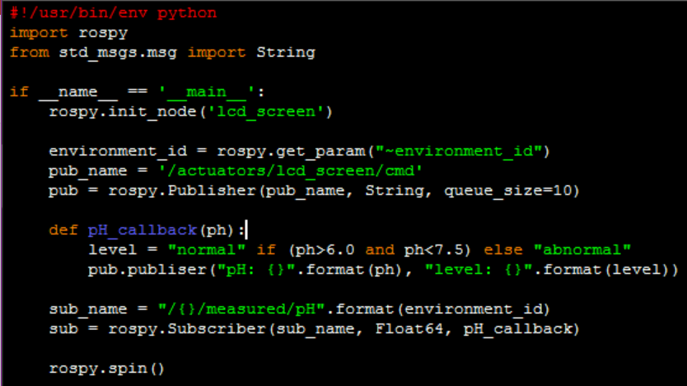
Possible additions
Adding a “normal” range for certain environmental parameters
Keeping track of parameters over time and stating deviations in average

